Slide 1
Intermediate arcpy
GIS Programming

Slide 2
Class preparation
No need to open a VM today
You'll want to download and open class10.ppt in order to see some small details such as
' vs. " vs. '' (the last is two single quotes)

Slide 3
ArcMap Python interpreter window
In ArcMap you can open a basic Python interpreter window to directly execute Python/arcpy commands
From the Geoprocessing menu choose Python (near the bottom)
You can then dock the floating window to the bottom of the ArcMap screen
To enter multiple commands before execution, press Ctrl and Enter at the end of each line to hold execution

Slide 4
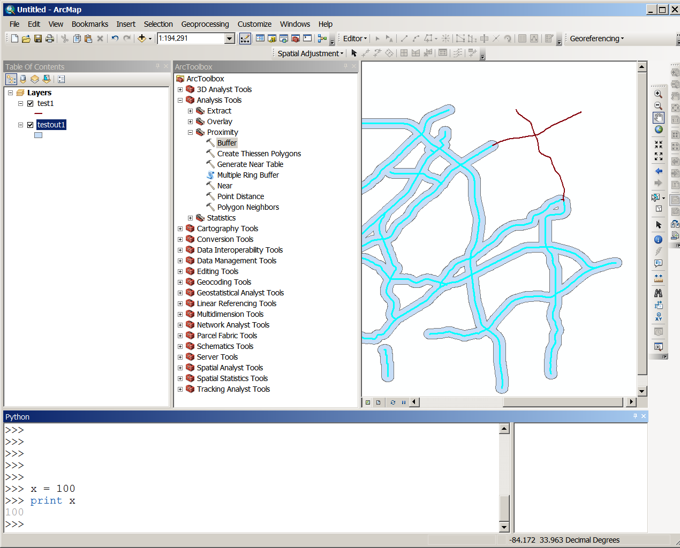


Slide 5
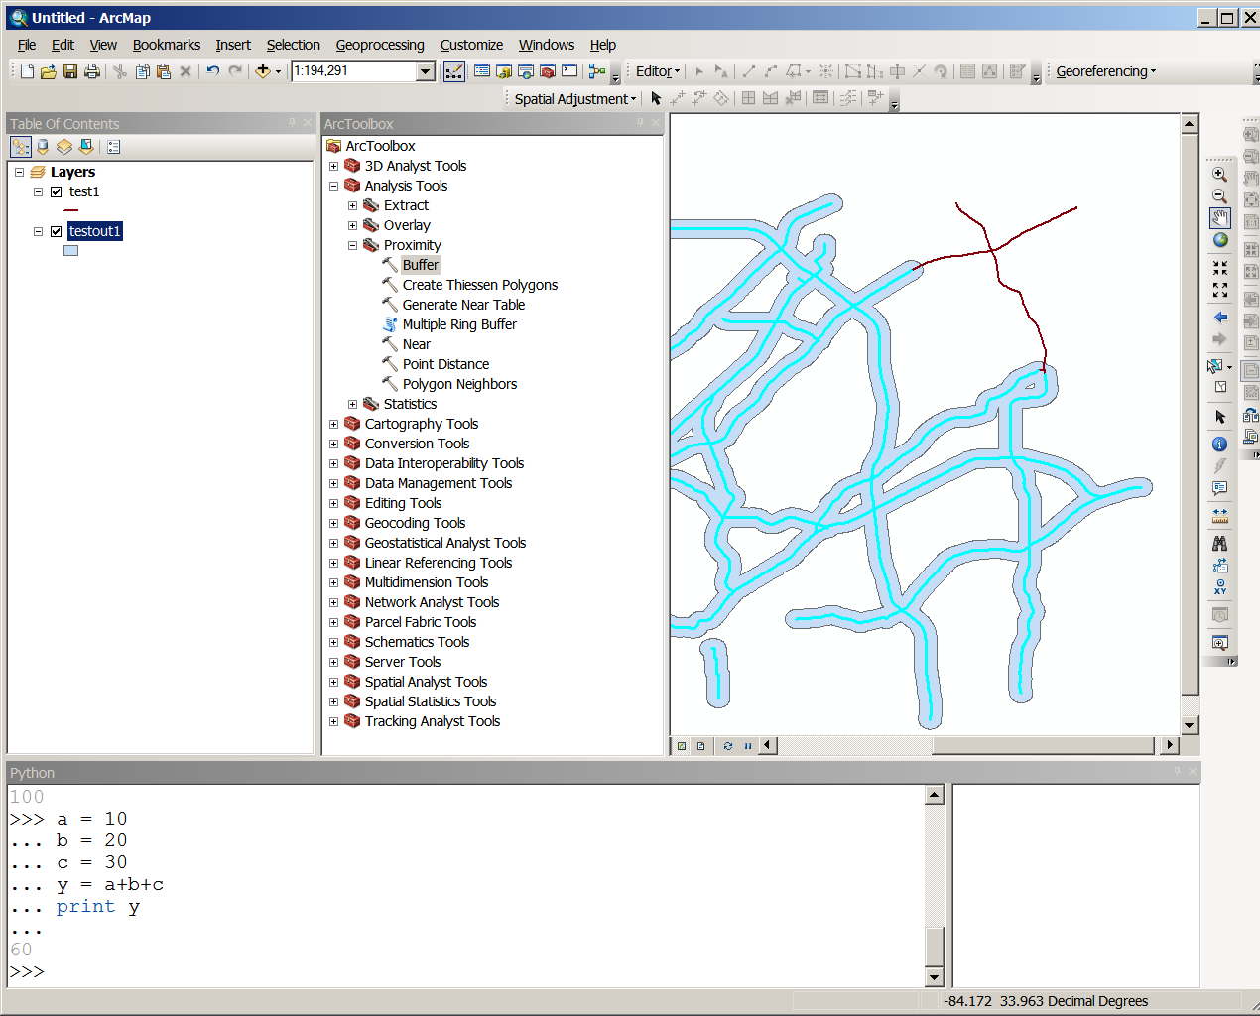

Slide 6
Grabbing Python/arcpy syntax by executing an ArcMap tool
You can retrieve the exact Python/arcpy syntax equivalent of from executing an ArcMap toolbox tool
Point and click to execute the ArcMap tool as normal
Open the Geoprocessing menu's Results window
Right-click on the tool name (Buffer, for example) and click on

Slide 7
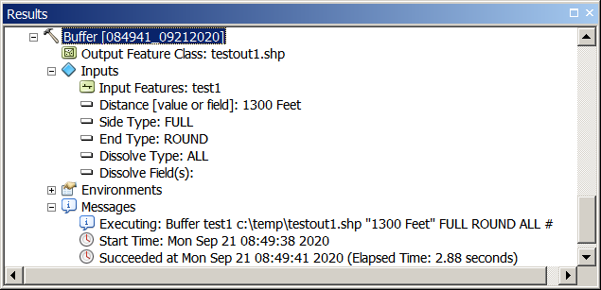
Right-click and select
Copy As Python Snippet
Use Ctrl-V to paste the syntax

Slide 8
Example Python snippet with added formatting for readability
# Replace a layer/table view name with a path to a dataset
# (which can be a layer file) or create the layer/table view
# within the script
# The following inputs are layers or table views: "test1"
arcpy.Buffer_analysis(in_features="test1", out_feature_class="c:/temp/testout1.shp",
buffer_distance_or_field="1300 Feet",
line_side="FULL",
line_end_type="ROUND",
dissolve_option="ALL",
dissolve_field="#")

Slide 9
To change the ArcMap Python editor and debugger to PyScripter
First determine the path to PyScripter.exe
  Open your Desktop PyScripter folder
  Right click on PyScripter.exe, select Properties
  Mouse-highlight the Location (the path to PyScripter.exe)
  Press Ctrl-C to copy into the copy buffer
In ArcMap select Geoprocessing / Geoprocessing Options
Use Ctrl-V to paste the path into the Editor and Debugger input areas
Add PyScripter.exe to the end of the path for both
To test, goto the Spatial Statistics Tools in the ArcMap toolbox and open the Analyzing Patterns toolset.
Right-click on the Average Nearest Neighbor tool and choose "Edit" from the drop-down menu
The Python script should then open in PyScripter

Slide 10
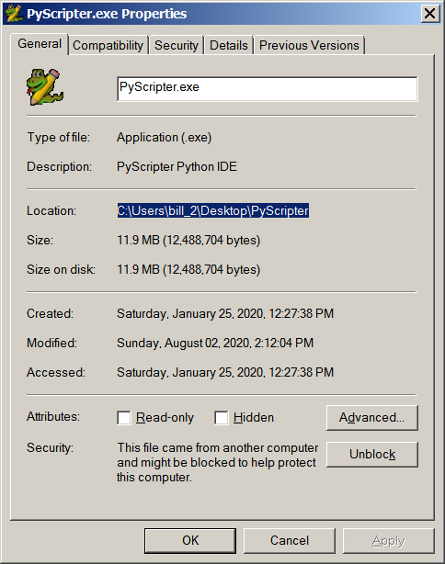
Open your
PyScripter folder
on your (VM)
Desktop
Find the PyScripter
application
Right-click on the
PyScripter.exe
application
Highlight the
location
Press Ctrl-C to copy

Slide 11
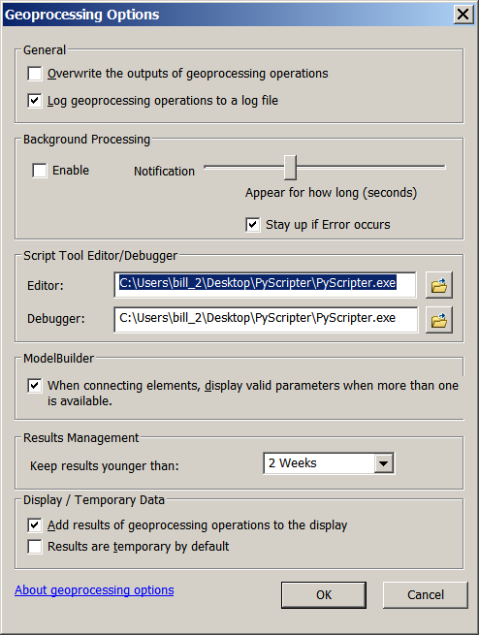
ArcMap
Geoprocessing
Options
Ctrl-V to paste the
path
Add \PyScripter.exe
to the path
Change both the
editor and debugger

Slide 12
To change the ArcMap Python editor and debugger to PyScripter
First determine the path to PyScripter.exe
  Open your Desktop PyScripter folder
  Right click on PyScripter.exe, select Properties
  Mouse-highlight the Location (the path to PyScripter.exe)
  Press Ctrl-C to copy into the copy buffer
In ArcMap select Geoprocessing / Geoprocessing Options
Use Ctrl-V to paste the path into the Editor and Debugger input areas
Add PyScripter.exe to the end of the path for both
To test, goto the Spatial Statistics Tools in the ArcMap toolbox and open the Analyzing Patterns toolset.
Right-click on the Average Nearest Neighbor tool and choose "Edit" from the drop-down menu
The Python script should then open in PyScripter

Slide 13
Accessing attribute data with arcpy’s three data cursors
Cursors are in the Data Access (da) module
Cursors are pointers to attribute records
The three cursors are independent; they can each point to different records
Search cursor gives us read access to fields
Update cursor gives us write access to fields and the ability to delete records
Insert cursor allows new records to be entered
Resetting a cursor places it at the first record

Slide 14
Basic search cursor (for loop and deletion for manual reset)
These statements establish the search cursor with the fields ROUTE and TOLL_RD, loop through the features, and delete the scursor variable and row variable
fc = "c:/temp/garoads.shp"
scursor = arcpy.da.SearchCursor(fc, ["ROUTE","TOLL_RD"])
for row in scursor:
print row[0], row[1]
del scursor, row
can be any convenient variable name

Slide 15
Basic search cursor (for loop and deletion for manual reset)
These statements establish the search cursor with the fields ROUTE and TOLL_RD, loop through the features, and delete the scursor variable and row variable
fc = "c:/temp/garoads.shp"
scursor = arcpy.da.SearchCursor(fc, ["ROUTE","TOLL_RD"])
for row in scursor:
print row[0], row[1]
del scursor, row
Python list with names of fields we want to access

Slide 16
Basic search cursor (for loop and deletion for manual reset)
These statements establish the search cursor with the fields ROUTE and TOLL_RD, loop through the features, and delete the scursor variable and row variable
fc = "c:/temp/garoads.shp"
scursor = arcpy.da.SearchCursor(fc, ["ROUTE","TOLL_RD"])
for row in scursor:
print row[0], row[1]
del scursor, row
can be any convenient variable name

Slide 17
Basic search cursor (for loop and deletion for manual reset)
These statements establish the search cursor with the fields ROUTE and TOLL_RD, loop through the features, and delete the scursor variable and row variable
fc = "c:/temp/garoads.shp"
scursor = arcpy.da.SearchCursor(fc, ["ROUTE","TOLL_RD"])
for row in scursor:
print row[0], row[1]
del scursor, row
list index of fields to access

Slide 18
Basic search cursor (for loop and deletion for manual reset)
These statements establish the search cursor with the fields ROUTE and TOLL_RD, loop through the features, and delete the scursor variable and row variable
fc = "c:/temp/garoads.shp"
scursor = arcpy.da.SearchCursor(fc, ["ROUTE","TOLL_RD"])
for row in scursor:
print row[0], row[1]
del scursor, row
can be any convenient variable name
fields we want to access
can be any convenient variable name
list index of fields to access

Slide 19
Search cursor with automatic reset
fc = "c:/temp/garoads.shp"
with arcpy.da.SearchCursor(fc, ["ROUTE", "TOLL_RD"]) as scursor:
for row in scursor:
print "Route = ", row[0]
Python “with” statement will apply an exit method (which is reset cursor for an arcpy cursor) automatically after loop execution.
Generally, after doing an operation you want to close a file and/or reset a cursor so you always know where a cursor will be starting

Slide 20
Cursor example with added where condition
Note the double-quote string within the larger single-quote string
fc = "c:/temp/garoads.shp"
fields = ["ROUTE", "TOLL_RD","LENGTH"]
wcondition = '"LENGTH" >= 100'
with arcpy.da.SearchCursor(fc, fields, wcondition) as scursor:
for row in scursor:
print "Route = ", row[0]
del scursor, row

Slide 21
What happens when we want to query a shapefile string field?
To query the ROUTE field we need a where clause like "ROUTE" = 'Interstate 85'
But how do we put quotes around it to indicate it's a string
We can't use " or '
One Python solution is to build the string out of pieces

Slide 22
dq = '"'
sq = "'"
fieldname = "ROUTE"
fieldvalue = "Interstate 85"
wclause = dq+fieldname+dq + " = " + sq+fieldvalue+sq
print wclause
"ROUTE" = 'Interstate 85'
wclause
'"ROUTE" = \'Interstate 85\''
In Python, the backslash means treat the next character as a literal character, not a special character, even if it's normally a special character

Slide 23
Adding a where clause
fc = "c:/temp/roads.shp"
cursor = arcpy.da.SearchCursor(fc, ["ROUTE", "TOLL_RD"])
wclause = """"TOLL_RD" = 'Y'"""
with arcpy.da.SearchCursor(fc, ["ROUTE", "TOLL_RD"], wclause) as cursor:
for row in cursor:
print "Route = ", row[0]
print "Toll = ", row[1]

Slide 24
Field delimiters differ by type of feature class
Problem: different feature class types need different field delimiters
File geodatabases and shapefiles use double quotation marks (" "), personal geodatabases use square brackets ([ ]), and enterprise geodatabases don't use field delimiters.
This works only for shapefiles and file geodatabases:
wclause = """"TOLL_RD" = 'Y'"""
The next two work for any ArcGIS feature class:
wclause = """%s = 'Y'""" %arcpy.AddFieldDelimiters(fc, "TOLL_RD")
wclause = """{0} = 'Y'""".format(arcpy.AddFieldDelimiters(fc, "TOLL_RD"))

Slide 25
Insert cursor example
# Create insert cursor for table
rows = arcpy.InsertCursor("c:/base/data.gdb/roads_lut")
# Create 25 new rows. Set the initial row ID and distance values
for x in xrange(1, 26):
row = rows.newRow()
row.setValue("rowid", x)
row.setValue("distance", 100)
rows.insertRow(row)
# Delete cursor and row objects to remove locks on the data
del row
del rows

Slide 26
Update cursor example
import arcpy
# Set the workspace
arcpy.env.workspace = "c:/base/data.gdb"
# Create the update cursor
cursor = arcpy.UpdateCursor("roads")
# Update the road buffer distance field based on road type.
# Road type is either 1,2,3,4 Distance is in meters.
for row in cursor:
row.setValue("BUFFER_DIST", row.getValue("TYPE") * 100)
cursor.updateRow(row)
# Delete cursor and row objects
del cursor, row

Slide 27
Working with files
f = open(‘address2.txt’)
f.read()
f.seek(0)
f.read(10)
f.seek(0)
lines = f.readlines()
f.close()

Slide 28
Writes a new file with replacement strings
input = open(‘address2.txt’)
output=open(‘address3.txt’, “w”)
for line in input:
str = line.replace(“Georgia” “Florida”)\
.replace(“GA” “FL”)
output.write(str)
input.close()
output.close()

Slide 29
Reading geometry
Geometry fields in feature classes include
  SHAPE@LENGTH
  SHAPE@XY: x,y coordinates tuple
  SHAPE@: the full geometry object
    A complex object that can only be accessed with arcpy-specific methods
    arcpy arrays are not an official Python data structure
    Python uses lists instead of arrays
    But arcpy arrays are a series of x.y tuples describing polylines or polygons

Slide 30
Geometry complexities
In shapefiles, for example
  A feature can multiple parts (Hawaii polygons)
  Each part has multiple points
To access the full geometry you must
  Loop over features
  Loop over parts
  Loop over points

Slide 31
Writing geometry
Uses the same three cursors
  Search, Update, and Insert
  But with the SHAPE@ complex object
Lines and polygons put their points into a special “array” structure, with is a sequence of x,y tuples
These statements establish special arcpy data objects:
  point = arcpy.Point() (an empty point)
  line_array = arcpy.Array() (an empty array)
  polygon = arcpy.Polygon(line_array) (a polygon using the points contained in line_array)

